Slide 1
Ecology
Interactions between biotic and abiotic factors

Slide 2
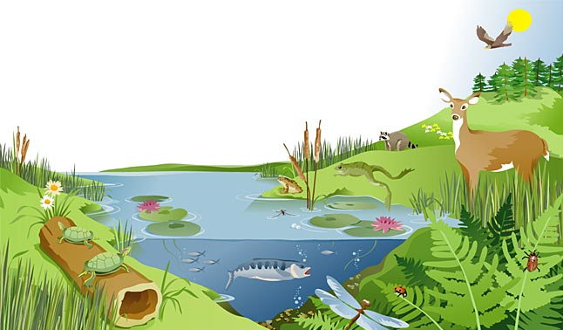
Review
biotic
A(n) ___________ factor is a living (or once living) component of an ecosystem.
A(n) ___________ factor is a non-living component of an ecosystem.
abiotic

Slide 3
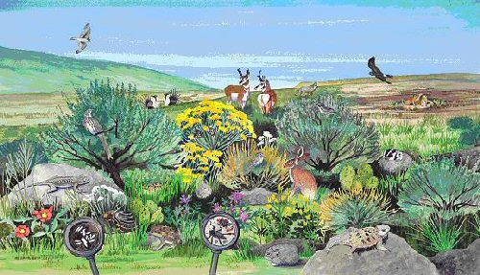
Review
biotic
An ecosystem is the interaction between __________ and
__________ factors
abiotic

Slide 4
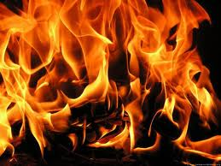
Biotic or Abiotic?
Biotic
Abiotic
Abiotic

Slide 5
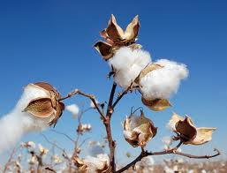
Biotic or Abiotic?
Biotic
Biotic
Abiotic

Slide 6
Biotic or Abiotic?
Biotic
Biotic
Abiotic

Slide 7
Biotic or Abiotic?
Biotic
Biotic
Abiotic

Slide 8
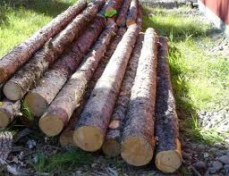
Biotic or Abiotic?
Biotic
Biotic
Abiotic

Slide 9
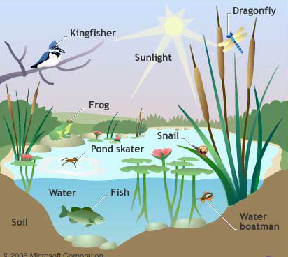
Interactions
How do these abiotic factors affect the biotic parts of an ecosystem?
Notes:
For example, if a lake becomes polluted or dries up during a drought, this may harm the fish or insects that live in the lake

Slide 10
Activity
Notes:
Hand out cue cards and work sheet

Slide 11
Activity
Trees
Fish
Water
Squirrels
Air

Slide 12
Activity
Trees
Temperature
Soil
Bacteria
Grass
Fish
Water
Sun
Squirrels
Deer
Air
Minerals
Flowers
Notes:
Sun-keeps organisms warm, food for green plants
Air-O2, CO2, N2: provides O2 for animals to breathe, CO2 for plants to make their own food
Minerals-found in soil
Bacteria-found in soil
Squirrels: eat conifer cones, seeds, nuts (so could be on trees)
Deer: wild flower plants, alfalfa, clover (in the summer)/ acorns (in the winter), also on small trees and bushes (in the spring)

Slide 13
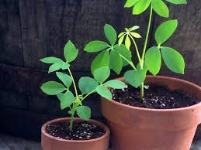
Interactions between biotic and abiotic factors
What abiotic factors are important for a plant to grow?
Notes:
Plants interact with sunlight and air to make their own food, and they use water and nutrients in the soil to grow
Tell students we are going to look at 4 main ones

Slide 14
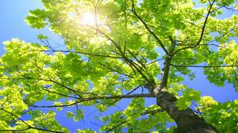
1. Sun
Provides warmth to living organisms
Provides solar energy (light) for green plants to make their own food
The number of hours of daylight triggers seasonal events, such as:
-plants flowering
-birds migrating
Notes:
Before I show them how sun can affect biotic things, ask the students what they think

Slide 15
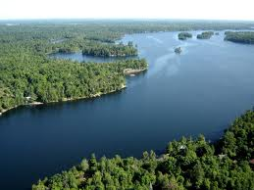
2. Water
Important for life processes of all living things (plants and animals) such as:
-distributing food particles through their bodies
-digesting food
Important for organisms
that live under water, such as:
-trout
-whales
-algae

Slide 16
3. Air
Provides oxygen (O2), which animals breathe
Provides carbon dioxide (CO2) for plants to use to make their own food
Notes:
Air is made up primarily of: N₂ -78%, O₂ - 21%, CO₂ -0.03%
Photosynthesis: sunlight + water + carbon dioxide → food + oxygen

Slide 17
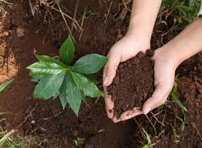
4. Soil
Provides a home for many animals that live underground
-earthworms
Provides nutrients for plants
Plants grow in soil
Notes:
The disappearance of the ant population from Earth would be a major disaster. Ants turn the soil, eat other insects, are scavengers of dead animals and pollinate plants.

