Slide 1
Ecology
Biotic vs. Abiotic

Slide 2
Trees
Temperature
Soil
Bacteria
Grass
Fish
What do the light green items have in common?
The dark green items?
Water
Sun
Squirrels
Deer
Air
Minerals
Flowers
Notes:
Students should be somewhat familiar to living and non-living components of an ecosystem

Slide 3
Biotic vs. Abiotic Factors
Biotic (living) | Abiotic (non-living)
Trees Grass Squirrels Flowers Deer Fish Bacteria | Temperature Water Soil Air Minerals Sun
Ecosystem:
-The interactions between living (biotic) and non-living (abiotic) factors
-They are everywhere…big and small
Notes:
Ask students if they can think of any others?

Slide 4
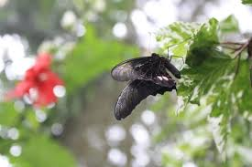
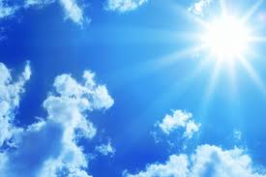
Biotic vs. Abiotic
Biotic: from the Greek word biōtikós, meaning life
Parts of an ecosystem that are living or were once living
Abiotic: ‘a’ meaning without
Parts of an ecosystem that are
non-living
Notes:
Have students copy down the definitions
Have students make a table in their notes of examples of each

Slide 5
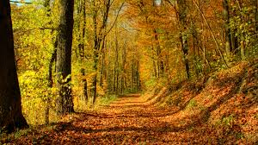
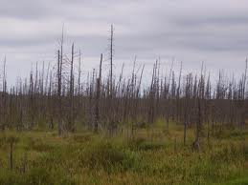
Abiotic? Biotic?

Slide 6
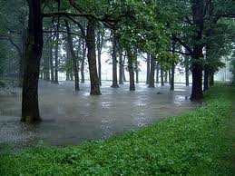
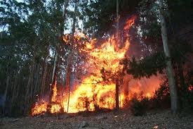
Abiotic? Biotic?

Slide 7
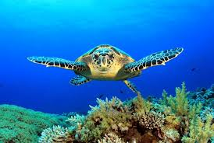
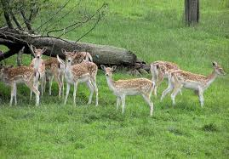
Abiotic? Biotic?

Slide 8
True or False?
1. You are abiotic.
True
False
False

Slide 9
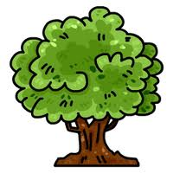
True or False?
2. A tree is biotic.
True
True
False

Slide 10
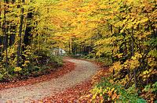
True or False?
3. Biotic includes living and formerly living things.
True
True
False

Slide 11
True or False?
4. Rain is biotic.
True
False
False

Slide 12
True or False?
5. Fire is abiotic.
True
True
False

Slide 13
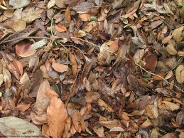
True or False?
6. Dead leaves are biotic.
True
True
False

Slide 14
True or False?
7. A rock is biotic.
True
False
False

Slide 15
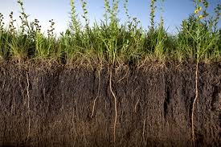
True or False?
8. Soil contains both abiotic and biotic parts.
True
True
False

Slide 16
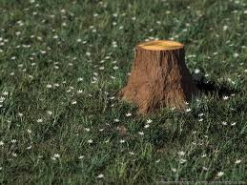
True or False
9. A tree stump is abiotic.
True
False
False

Slide 17
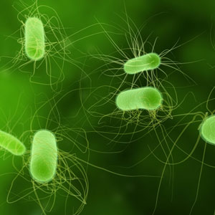
True or False?
10. Bacteria are abiotic.
True
False
False

Slide 18
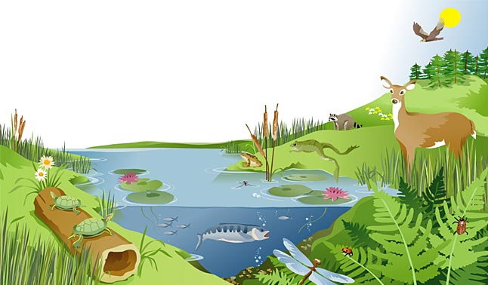
Biotic, Abiotic?

