Slide 1
Ecology
Producers

Slide 2
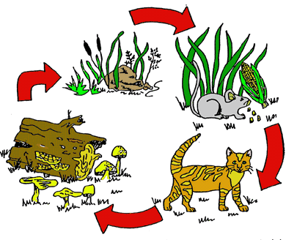
Components of a Food Chain
PRODUCERS
SUN
3. CONSUMERS
4. DECOMPOSER

Slide 3
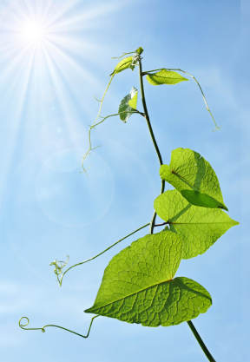
Producers
How do humans get their energy?
-they eat food!
How do plants get their energy?
Do plants eat food?
-No!!! But how?
Plants produce their own
food from the abiotic environment

Slide 4
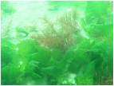
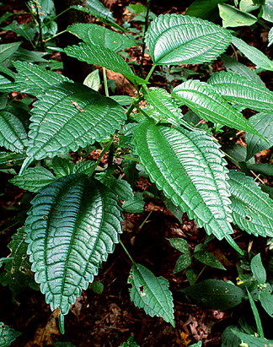
Producers
Producers are organisms that make their own food using air, sunlight, and water
Such as, green plants and algae

Slide 5
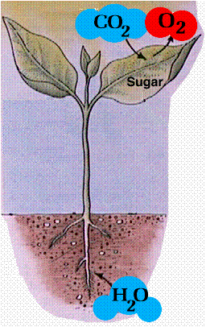
Photosynthesis
Photosynthesis is the process by
which green plants make their
own food using the sun’s energy,
water and carbon dioxide.
Formula:
Sunlight + CO2 + Water (H20) → O2 + Glucose (C6H12O6)
Notes:
Glucose, type of sugar found in corn, rice, potatoes

Slide 6
Producers
Without plants there would be no food (energy) for the rest of the food chain
ALL energy in every food
chain begins with the sun!

Slide 7
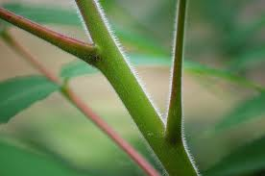
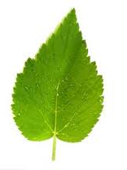
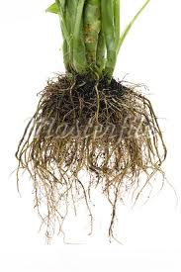
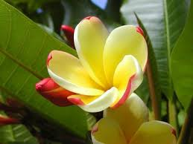
What part of the plant is for making food?

Slide 8
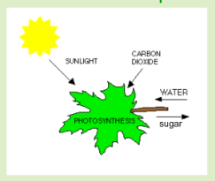
What part of the plant is for making food?
Most of the energy is captured in the leaves
The leaves make
Sugar from sunlight,
water, and carbon
dioxide. This is the
plants food.

Slide 9
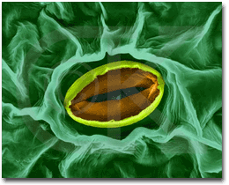
Photosynthesis
Leaves have little openings called stomata
These stomata on the leaves are used for gas exchange

Slide 10
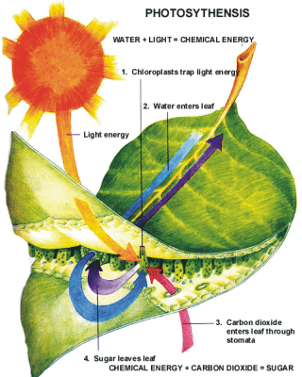
Photosynthesis
Close-up of a Chloroplast!

Slide 11
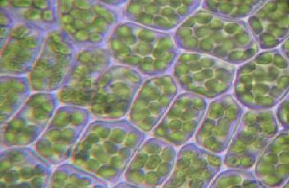
Photosynthesis
Photosynthesis occurs in the chloroplasts
Notes:
Chloroplasts are little organelles

Slide 12
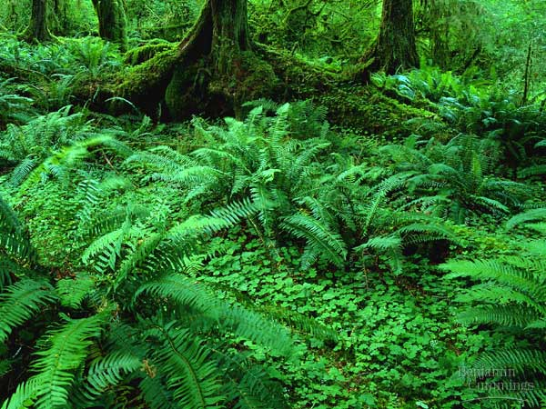
Photosynthesis
Plants absorb light
primarily using the
pigment chlorophyll.
There is so much
chlorophyll it masks
the other pigments.
Notes:
The chlorophyll pigment is found in the chloroplasts

Slide 13
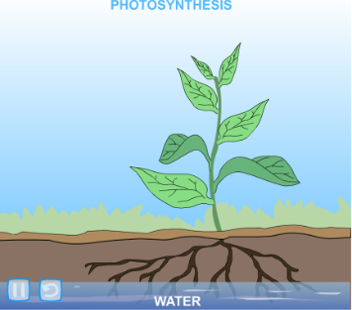
Photosynthesis: Review

Slide 14
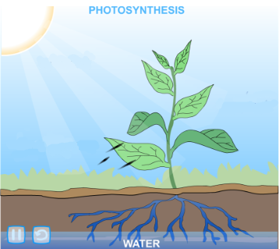
Photosynthesis: Review
Notes:
Take in water and sunlight
What does the air provide to plants? CO2

Slide 15
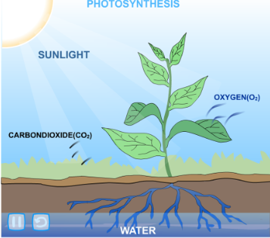
Photosynthesis: Review
Notes:
Takes in CO2 and gives off O2

Slide 16
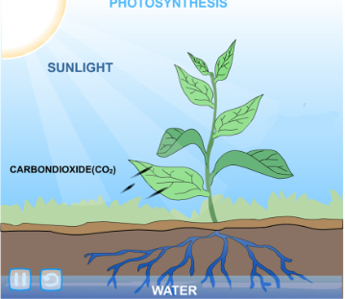
Photosynthesis: Summary
The roots take in water
The stem carries it up to the leaves
The leaves take in CO2 and sunlight
Once all three are together in the
leaf (water, sunlight, CO2),
the leaf changes it to sugar
(glucose)

Slide 17
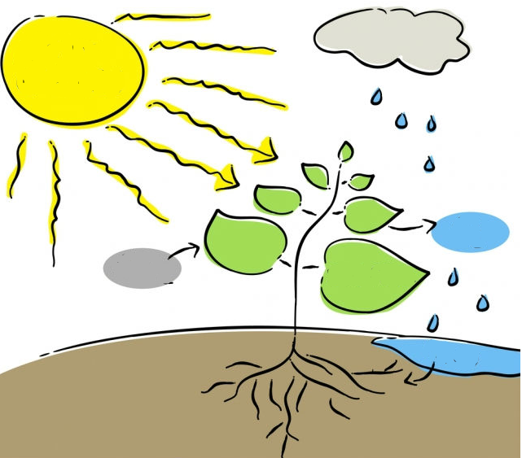
Label the three things a plant needs to make its own food and where the food is made:
Notes:
Label the sunlight, co2, o2, water, and where the sugar is made

